Slide 1
Module 1: Properties and Handling of Particulate Solids (Chapter 28)
Lecture 1
Somak Chatterjee

Slide 2
Introduction
Chemical Engineering (Late 1800s)
Unit Operations (1915)
Mechanical Operations
Fluid Flow
Unit Processes (1923)
Oxidation, Hydration, Hydrogenation, Halogenation, Nitration, Etc.
Heat Transfer
Mass Transfer
Properties of Solids
Size Reduction
Size Separation
Transportation of solids
Mixing
Feeding etc.
Classification of Chemical Processes

Slide 3
Introduction
Solids are more difficult to handle than liquids or gases
Of all the shapes and sizes that may be found in solids, the most important from a chemical engineering standpoint is the small particle.
An understanding of the characteristics of masses of particulate solids is necessary in designing processes and equipment for dealing with streams containing such solids.

Slide 4
Properties of Solids
The most important properties of pieces of solids include
Density
  Mass per unit volume
Hardness
  Resistance of solids to be scratched
Fragility
  How easy of the particle to crumble into smaller pieces
Tenacity
  Resistance to collisions

Slide 5
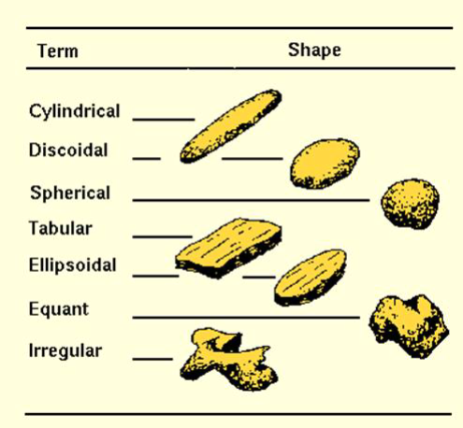
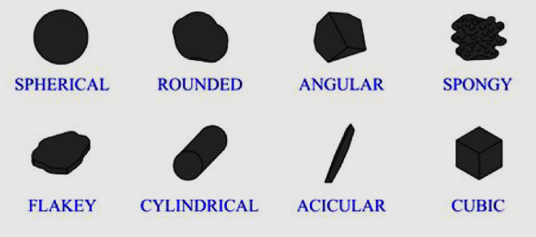
Particle Shapes

Slide 6
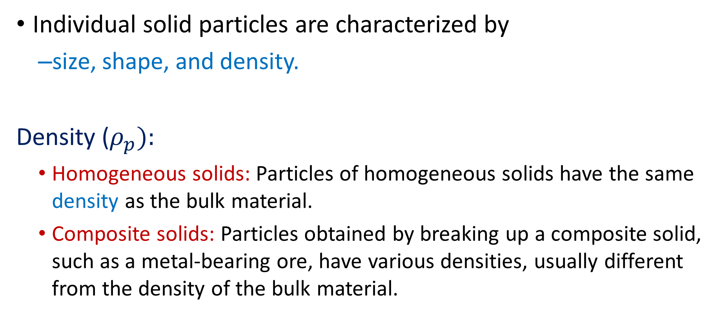
Characterization Of Solid Particles
Individual solid particles are characterized by
  size, shape, and density.
Density ($ρ_{p}):$
  Homogeneous solids: Particles of homogeneous solids have the same density as the bulk material.
  Composite solids: Particles obtained by breaking up a composite solid, such as a metal-bearing ore, have various densities, usually different from the density of the bulk material.

Slide 7
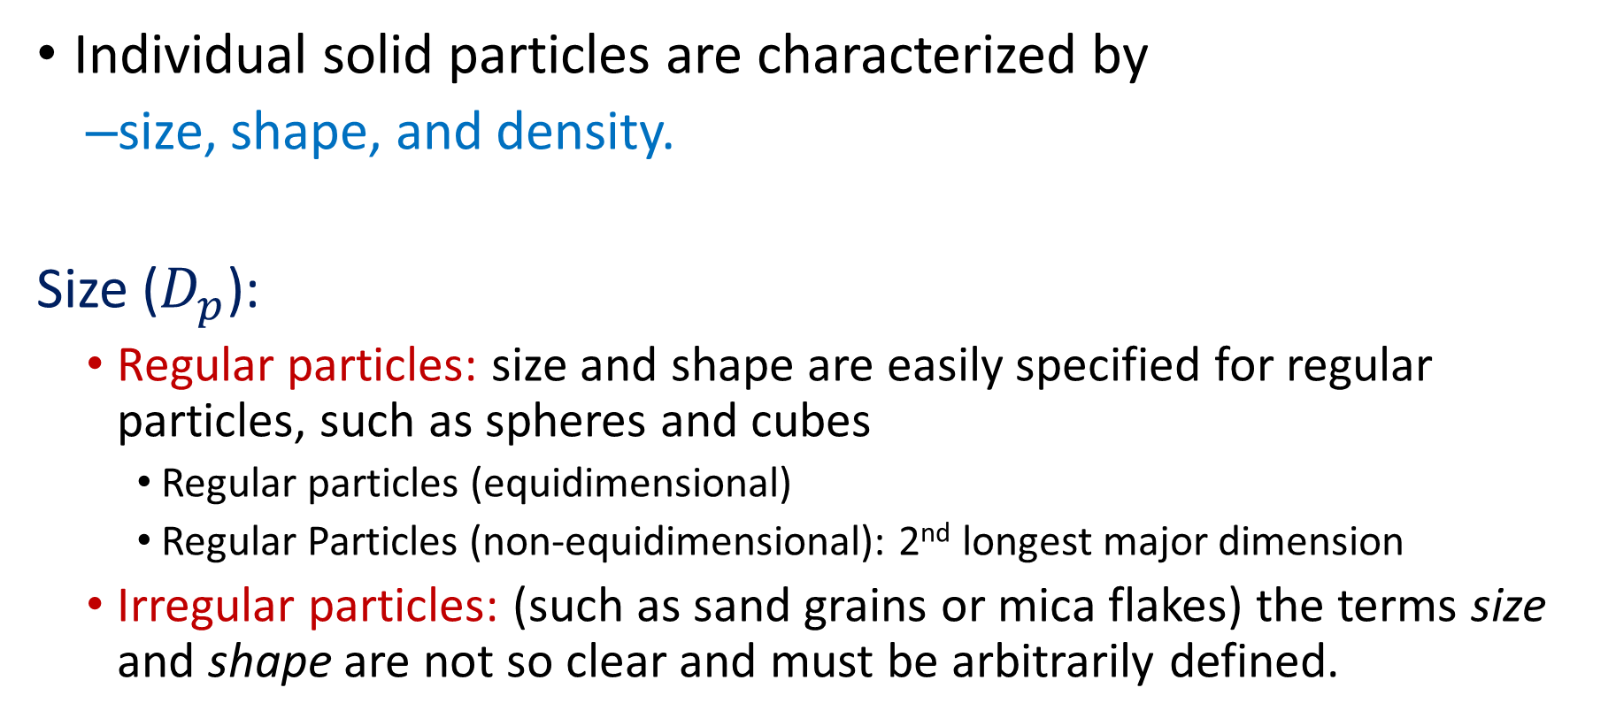
Characterization Of Solid Particles
Individual solid particles are characterized by
  size, shape, and density.
Size ($D_{p}$):
  Regular particles: size and shape are easily specified for regular particles, such as spheres and cubes
    Regular particles (equidimensional)
    Regular Particles (non-equidimensional): 2nd longest major dimension
  Irregular particles: (such as sand grains or mica flakes) the terms size and shape are not so clear and must be arbitrarily defined.

Slide 8
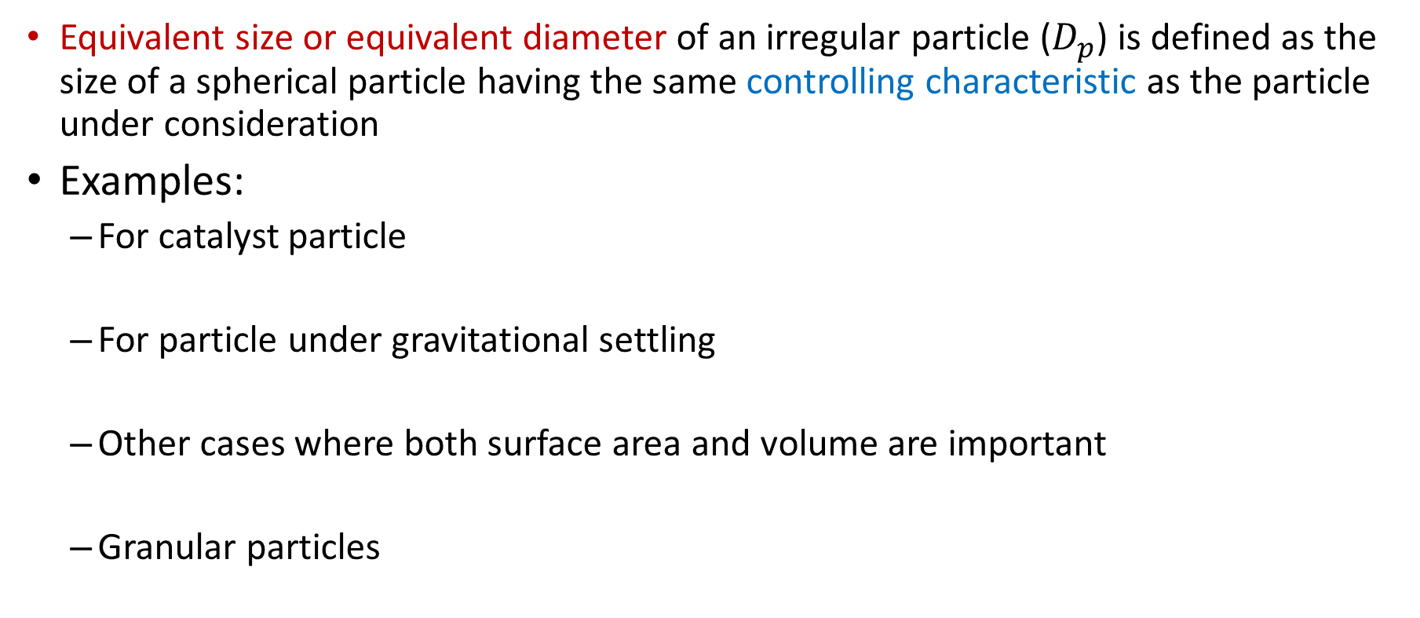

Size ($D_{p}$) of an irregular particle
Equivalent size or equivalent diameter of an irregular particle ($D_{p}$) is defined as the size of a spherical particle having the same controlling characteristic as the particle under consideration
Examples:
  For catalyst particle
  For particle under gravitational settling
  Other cases where both surface area and volume are important
  Granular particles

Slide 9
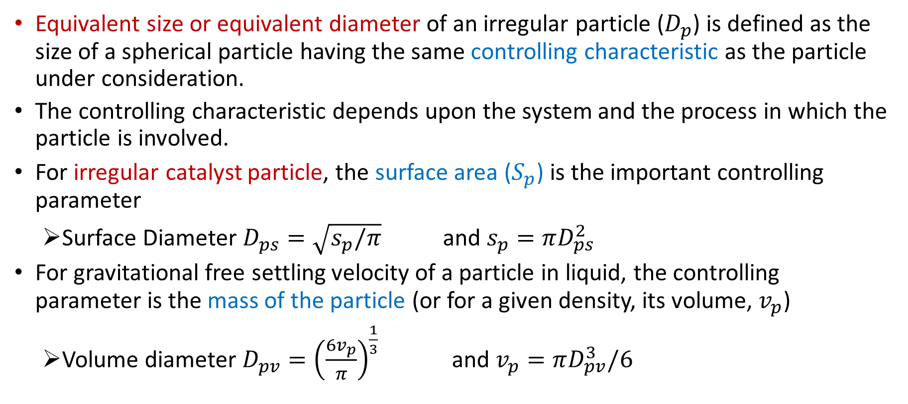
Size ($D_{p}$) of an irregular particle
Equivalent size or equivalent diameter of an irregular particle ($D_{p}$) is defined as the size of a spherical particle having the same controlling characteristic as the particle under consideration.
The controlling characteristic depends upon the system and the process in which the particle is involved.
For irregular catalyst particle, the surface area ($S_{p}$) is the important controlling parameter
  Surface Diameter $D_{ps}=\sqrt{s_{p}/π}$ and $s_{p}=πD_{ps}^{2}$
For gravitational free settling velocity of a particle in liquid, the controlling parameter is the mass of the particle (or for a given density, its volume, $v_{p}$)
  Volume diameter $D_{pv}={\left(\frac{6v_{p}}{π}\right)}^{\frac{1}{3}}$ and $v_{p}=πD_{pv}^{3}/6$

Slide 10
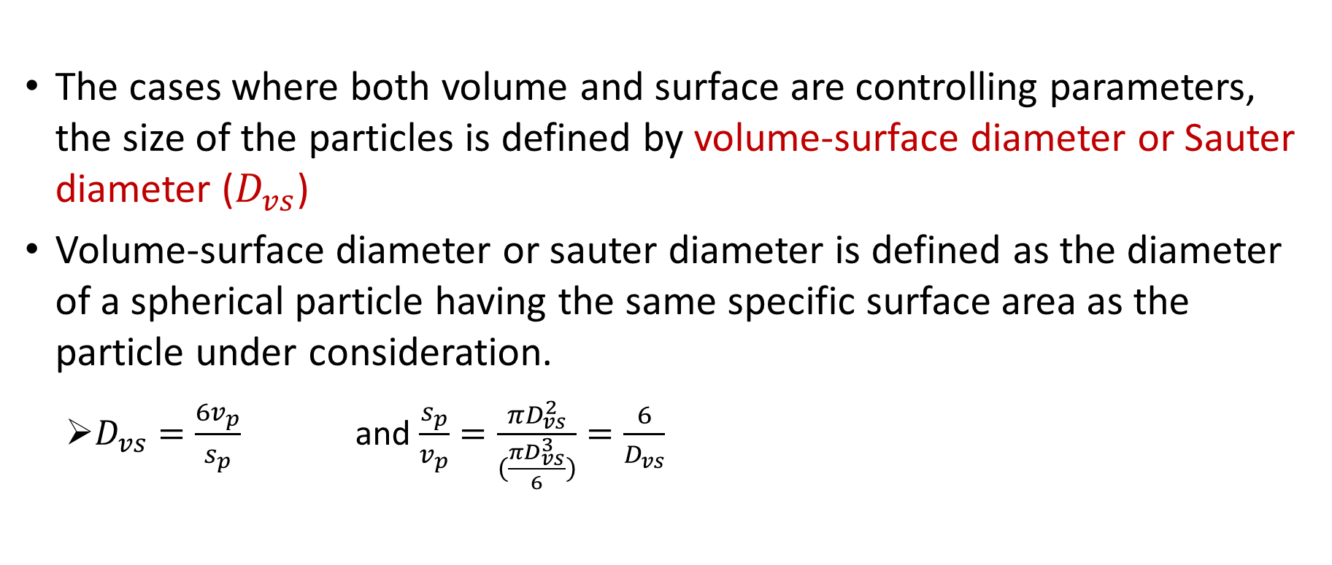

Size ($D_{p}$) of an irregular particle cont..
The cases where both volume and surface are controlling parameters, the size of the particles is defined by volume-surface diameter or Sauter diameter ($D_{vs}$)
Volume-surface diameter or sauter diameter is defined as the diameter of a spherical particle having the same specific surface area as the particle under consideration.
  $D_{vs}=\frac{6v_{p}}{s_{p}}$ and $\frac{s_{p}}{v_{p}}=\frac{πD_{vs}^{2}}{(\frac{πD_{vs}^{3}}{6})}=\frac{6}{D_{vs}}$

Slide 11
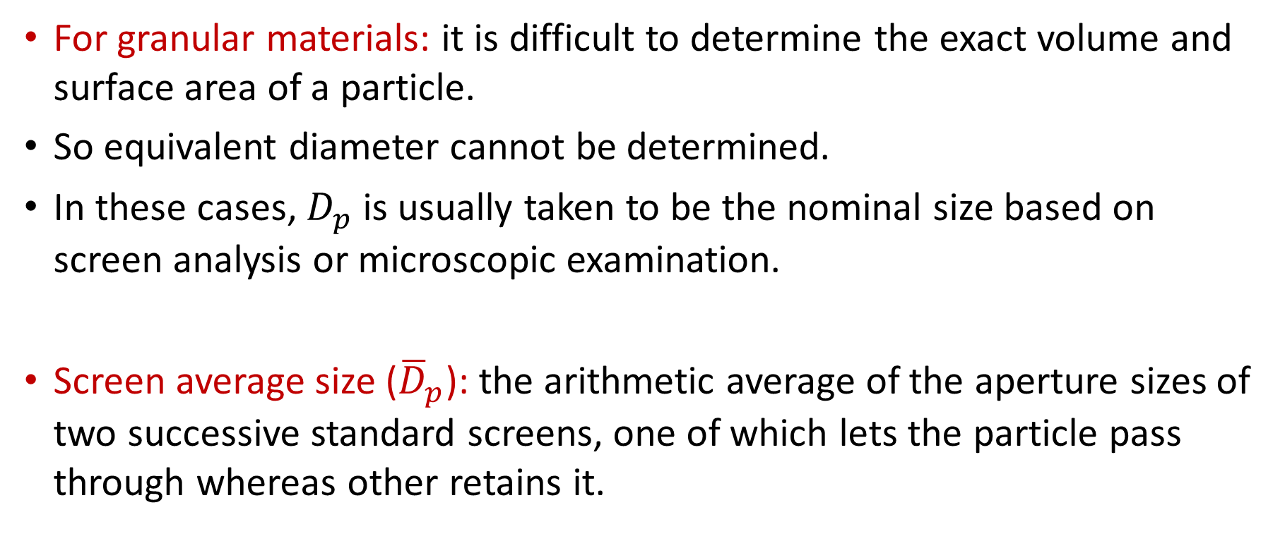
Size of granular materials
For granular materials: it is difficult to determine the exact volume and surface area of a particle.
So equivalent diameter cannot be determined.
In these cases, $D_{p}$ is usually taken to be the nominal size based on screen analysis or microscopic examination.
Screen average size (${\overline{D}}_{p}$): the arithmetic average of the aperture sizes of two successive standard screens, one of which lets the particle pass through whereas other retains it.

Slide 12
Statistical Diameters
Reference: Unit Operations of Particulate Solids: Theory and Practice, Enrique Ortega-Rivas, CRC Press, 2011

Slide 13
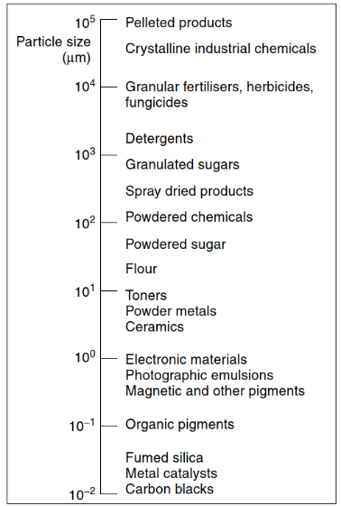
Sizes of typical powder particles
Measurement of particle size
Coarse particles
Fine particles
Very fine
Ultrafine particles

Slide 14


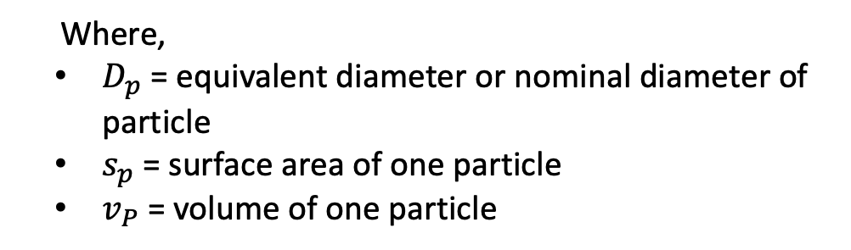
Particle Sphericity
Definition:
${Sphericity=Φ}_{s}$
$$=\frac{\text{Surface} \text{area} \text{to} \text{volume} \text{ratio} \text{of} \text{a} \text{sphere} \text{of} \text{diameter} \text{of} \text{particle}}{\text{Surface} \text{area} \text{to} \text{volume} \text{ratio} \text{of} \text{the} \text{particle}}$$
  Where,
  $D_{p}$ = equivalent diameter or nominal diameter of particle
  $s_{p}$= surface area of one particle
  $v_{P}$= volume of one particle
$Φ_{s}=\frac{6v_{p}}{D_{p}s_{p}}$

Slide 15
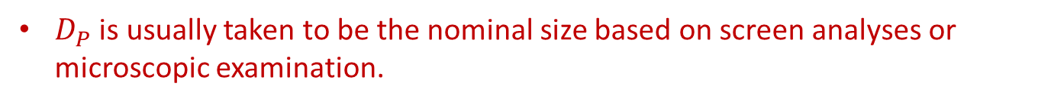
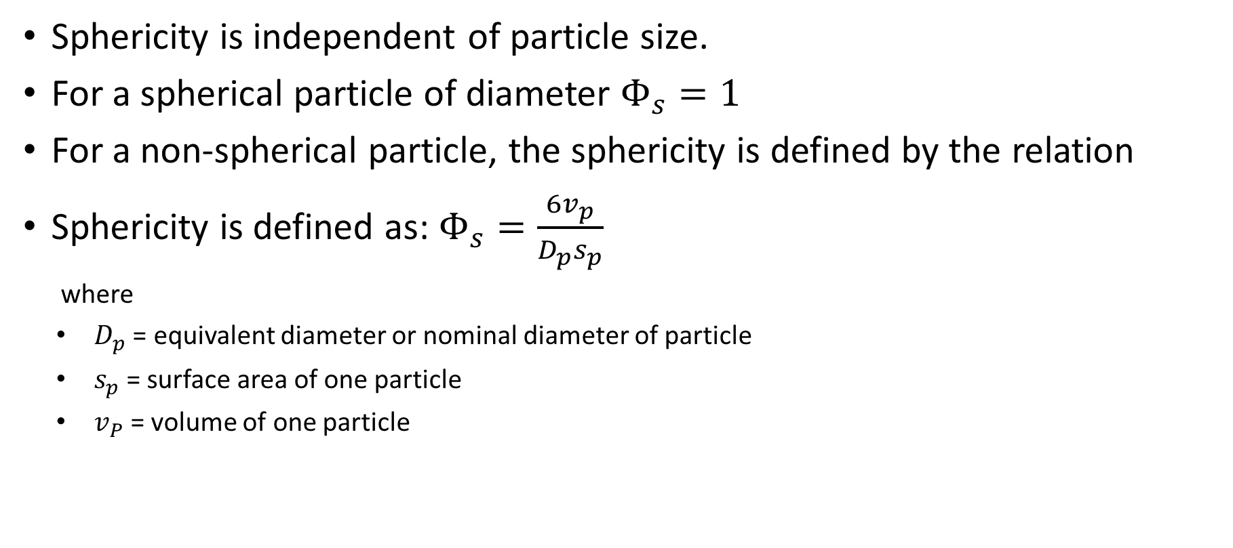
Particle Shape
Sphericity is independent of particle size.
For a spherical particle of diameter $Φ_{s}=1$
For a non-spherical particle, the sphericity is defined by the relation
Sphericity is defined as: $Φ_{s}=\frac{6v_{p}}{D_{p}s_{p}}$
  where
  $D_{p}$ = equivalent diameter or nominal diameter of particle
  $s_{p}$= surface area of one particle
  $v_{P}$= volume of one particle
$D_{P}$ is usually taken to be the nominal size based on screen analyses or microscopic examination.

Slide 16
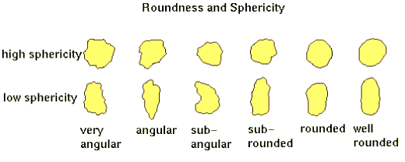
Particle Sphericity

Slide 17
Particle Shape
Diagram
Sphericity
Diagram
Sphericity
Table 28.1

Slide 18
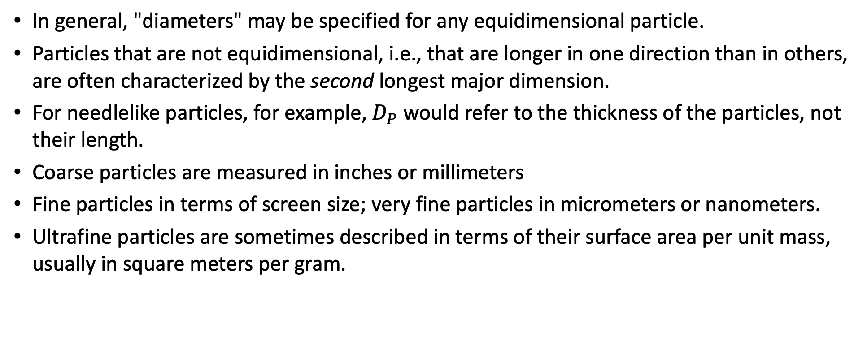
Particle Size
In general, "diameters" may be specified for any equidimensional particle.
Particles that are not equidimensional, i.e., that are longer in one direction than in others, are often characterized by the second longest major dimension.
For needlelike particles, for example, $D_{P}$ would refer to the thickness of the particles, not their length.
Coarse particles are measured in inches or millimeters
Fine particles in terms of screen size; very fine particles in micrometers or nanometers.
Ultrafine particles are sometimes described in terms of their surface area per unit mass, usually in square meters per gram.

Slide 19
Particle Size Determination
Screening > 50 µm
Sedimentation and elutriation > 1 µm
Permeability method: 1 µm
Instrumental Particle size analysers :
  Electronic particle counter – Coulter Counter, Laser diffraction analysers, X-Ray or photo sedimentometers, dynamic light scattering techniques

Slide 20
Course Handout and Chamber Consultation
Course Handout:
Chamber Consultation (Please write your doubts to somak.chatterjee@pilani.bits-pilani.ac.in)

Slide 21
References
Smith, J., Harriott, P., McCabe, W. (2005). Unit Operations of Chemical Engineering. Colombia: McGraw-Hill Education.
Swain, A. K., Patra, H., & Roy, G. K. (2011). Mechanical operations. Tata McGraw Hill.

